Slide 1
Fleet management system
Date: 29.06.2021 Course: Internet Applications Programming Group #8

Slide 2
Team members
Monika Rosa 239113
Godfrey Mghase 239195
Stanisław Puławski 239111
Wiktor Muraszko 239109

Slide 3

Project Objective(s)
Create an IT System for managing car fleet for the company, which consists of a headquarter and one branch office.
Implement a business process to enable the branch manager to request a car from the headquarter office.

Slide 4
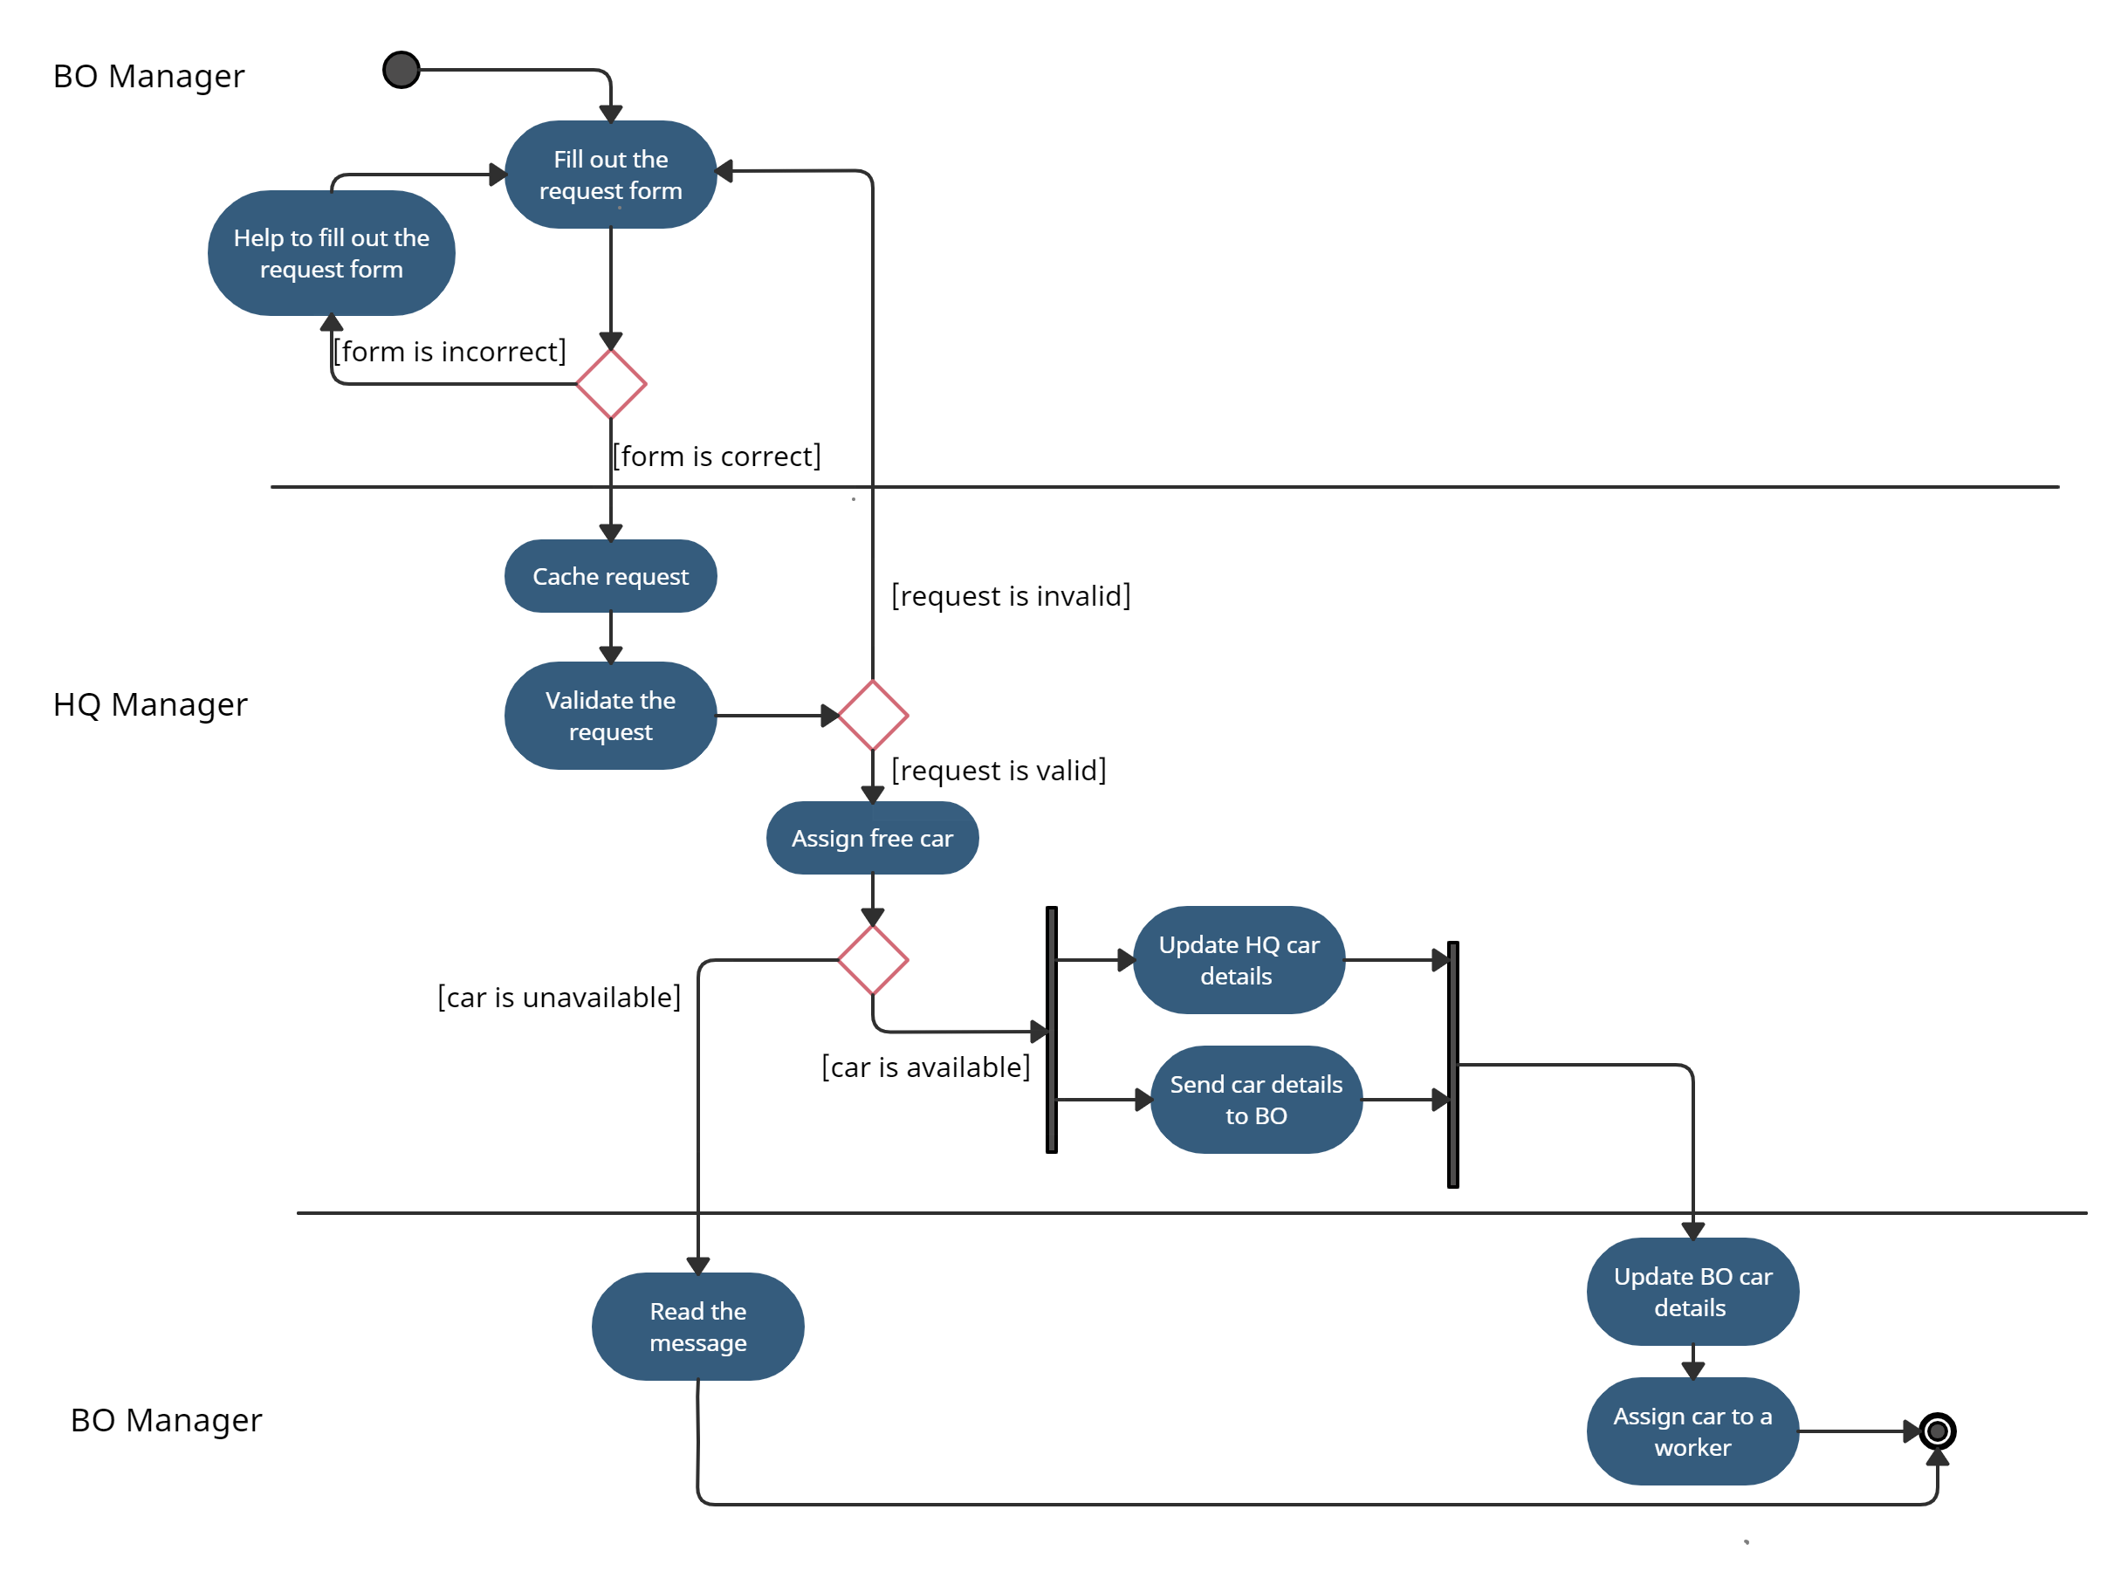
Car request
process

Slide 5
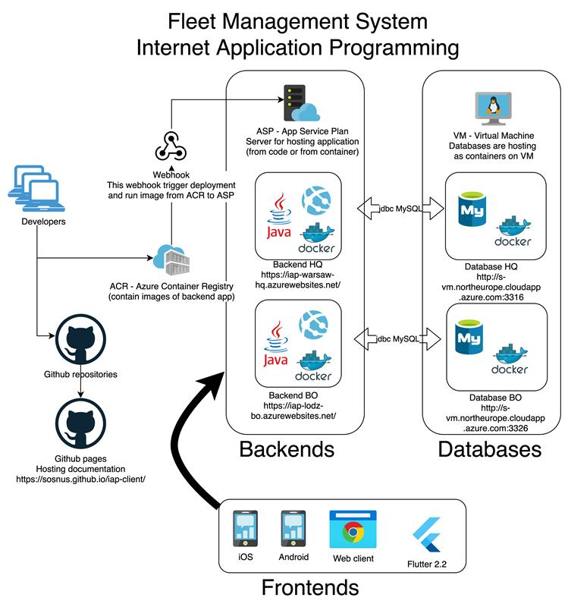
Solution Architecture

Slide 6
Technology Stack
Database
MySQL MySQL Server 8.0.23-1debian10
Backend
Java Spring Spring Boot (v2.4.3)
Frontend
Flutter Flutter 2.2.2
Android
Web
iOS

Slide 7

Java Spring Boot
AutoConfiguration
Starter POMs
Spring Boot CLI
Actuator
Spring Boot Initializer

Slide 8
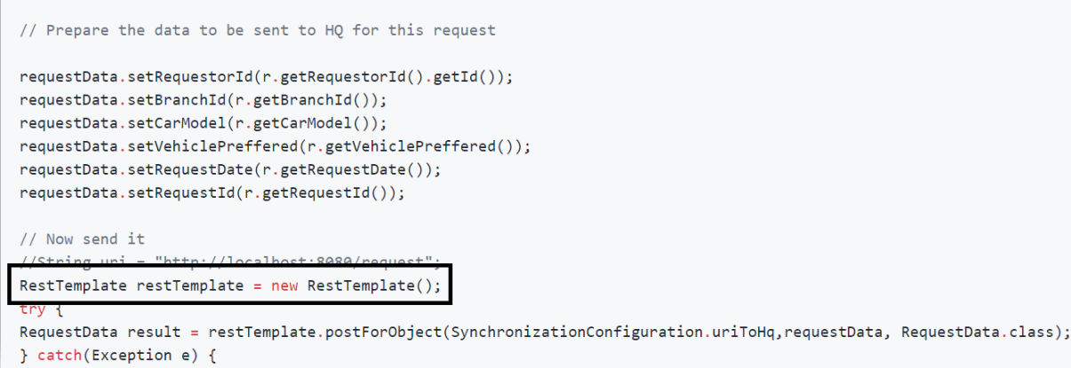
Data Exchange
Prepare an object and invoke the post method for transfer
Kliknij, aby dodać tekst

Slide 9
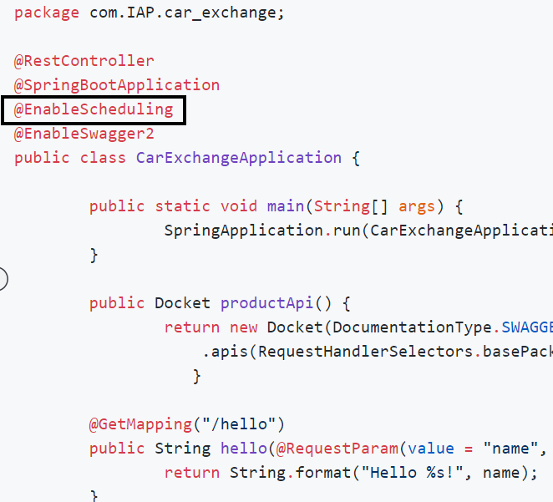
Data Sync
Enable Scheduling in spring boot main application using @ annotation.
Call @Scheduled to any method.
Enable Swagger by using @ EnableSwagger2 annotation at the main application file in spring boot.
SYNC is scheduled after every 10 seconds.

Slide 10
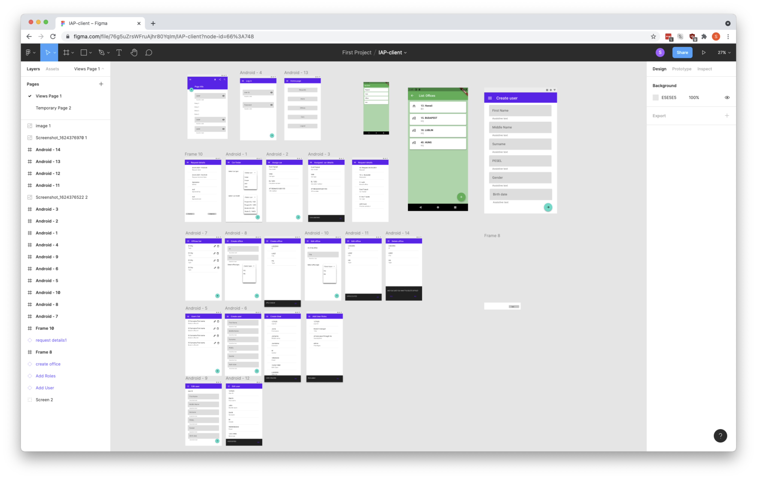
UI design Figma

Slide 11
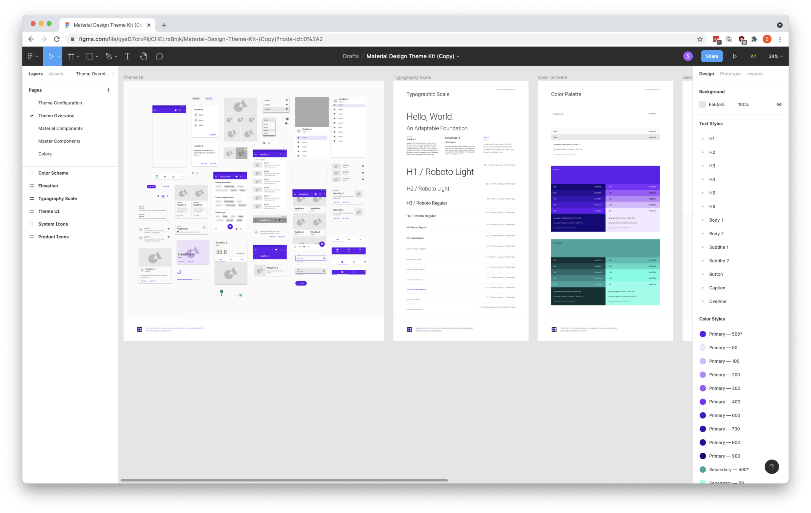
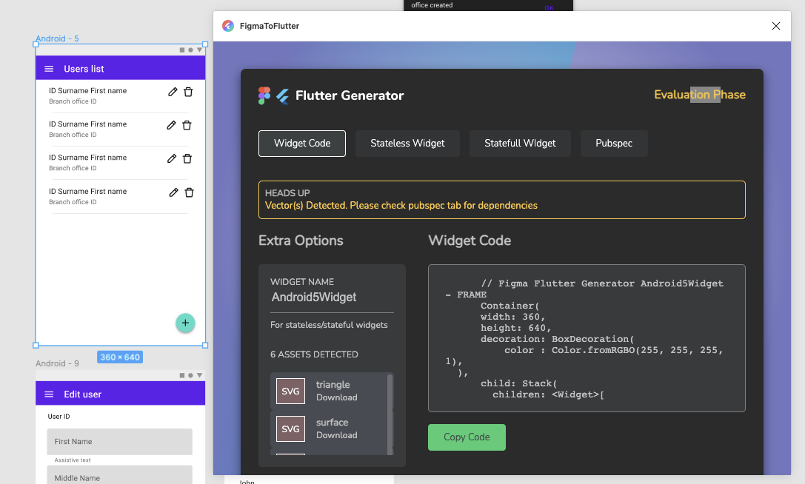
Themes, plugins, kits

Slide 12
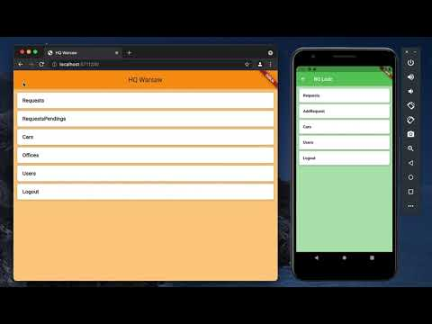
Client in action

Slide 13
Car Fleet Manager App (frontend)
Features depends on type of office (HQ/BO)
UI adapts to many resolution and screen proportions
Multiplatform (Android, iOS, Web)
UI based on Material Design

Slide 14

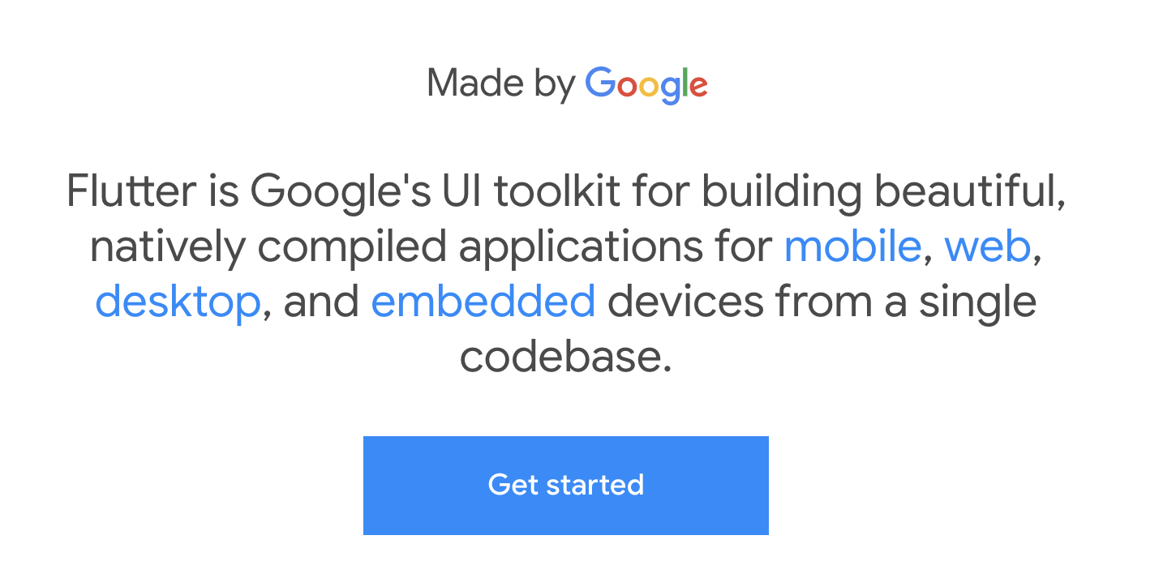

Slide 15
Flutter
Free
Open Source
Dart framework
Null-safety
Multiplatform
Mobile (Android, iOS)
Web (Chrome engine)
Desktop (Windows, Linux, MacOS, FuchsiaOS)
Hot reload

Slide 16
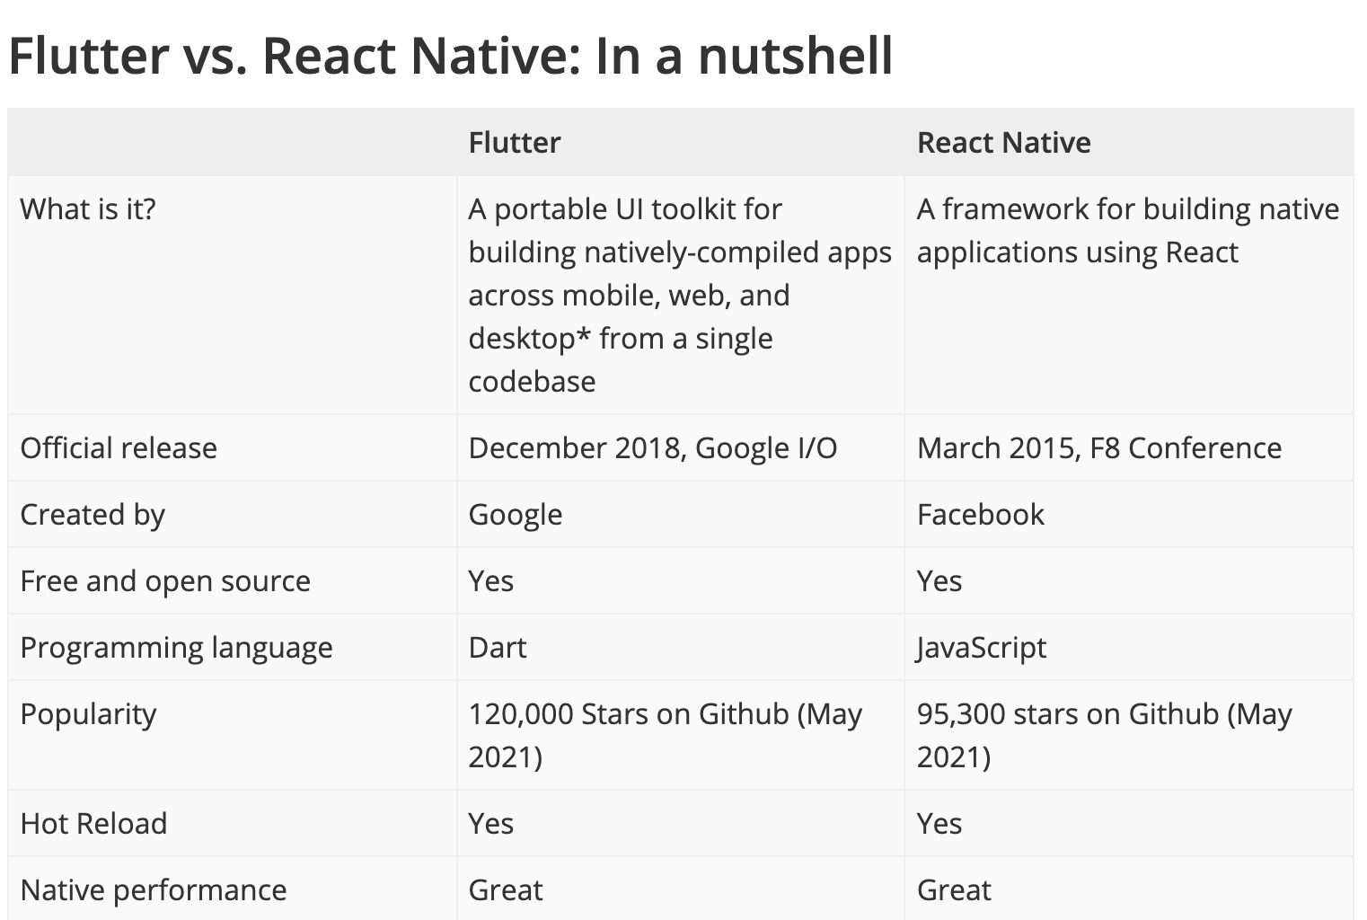

Slide 17
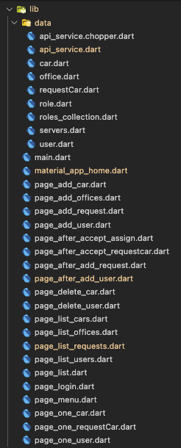
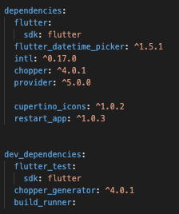
Important frontend libraries
Provider – state management
Chopper – API consumption
Build runner – to generate Chopper file
Material Design – UI, controls

Slide 18
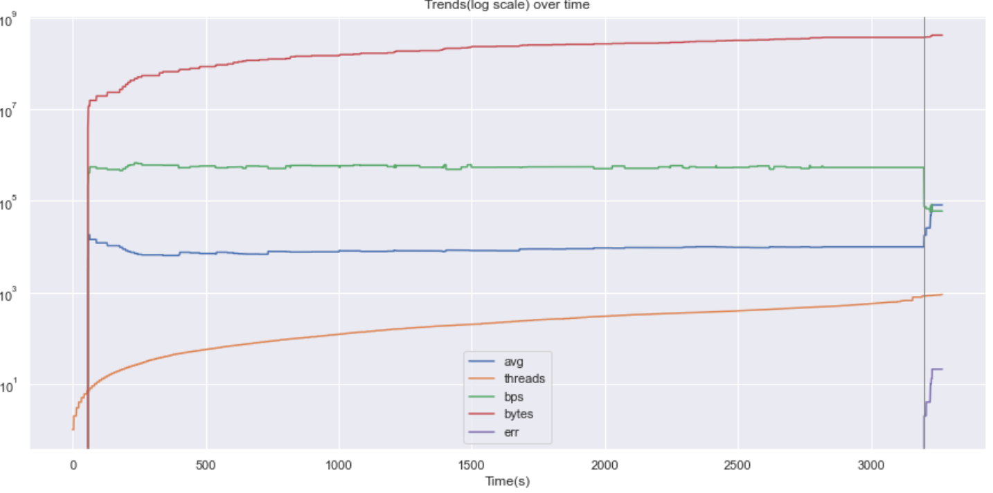
Performance Analysis
Testing Tool: SoapUI 5.6.0
Testing Computer: 8GHz RAM and Core i5-4258U CPU @2.4GHz 2.4GHz
Testing Strategy: Thread
Virtual users/Threads: 836
Data volume sent: 360 GB
Speed: 72 mbps
Average response time: 9.6s

Slide 19
Deployment
docker login sosnuscontainers.azurecr.io # login: ******** # password: ********* docker build -t sosnuscontainers.azurecr.io/iap-warsaw-hq . docker push sosnuscontainers.azurecr.io/iap-warsaw-hq
Steps:
TODO: Docker push on every commit on Github (using Github Actions)
Docker push (to ACR)
Webhook run deployment process (send new image to WebApplication)
Done!

Slide 20
Solution Architecture

Slide 21
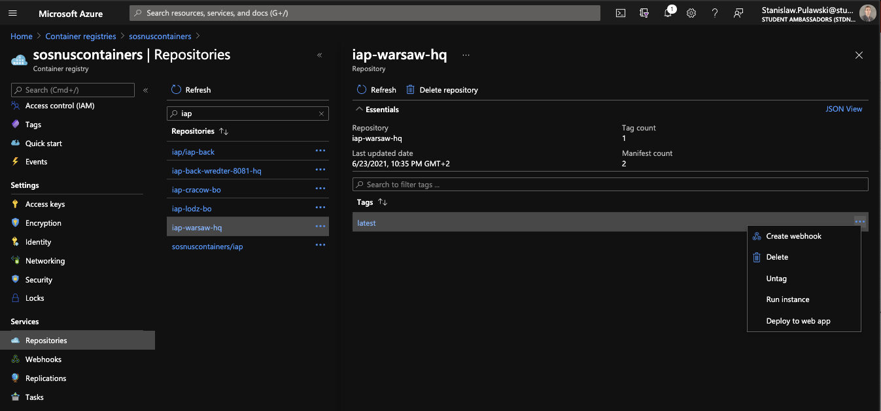
ACR – Azure Container Registry

Slide 22
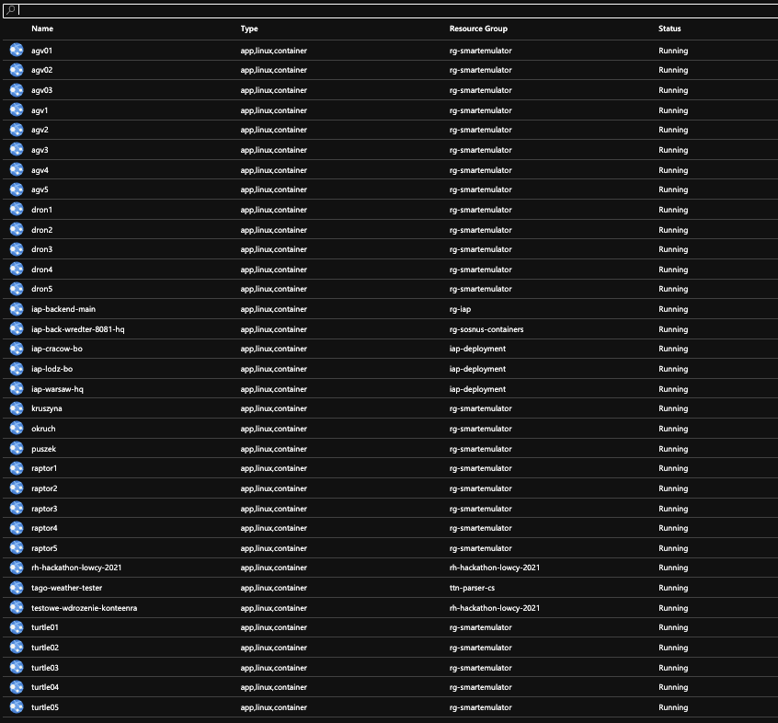
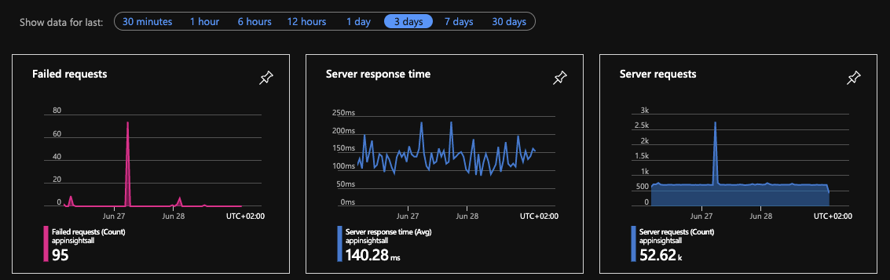
ASP– App Service Plan

Slide 23
Documentation
Markdown
Github
Github pages
Read The Docs
Export HTML/PDF
Git

Slide 24
Tools - sum-up
VS Code, Eclipse
DBeaver, MySQL
Docker, Android emulator
Azure – ASP, ACR
Swagger, Chopper
Postman, SoapUI
Figma, Material Design
Git, Github, G. Desktop, G. Pages

Slide 25
Future Works
Implement a new business process
Integrate more branch offices

Slide 26

Conclusion
"During project realization I had used Figma application in order to design views, which was a new experience for me. Due to Figmaʼs useful prototyping features, I plan to use this tool in the future as well."

Slide 27
Conclusion
"It was a joyous moment to realize data exchange and synchronization between two APIs and observing that the setup works as it is supposed to work despite the fact that, I never programmed in java spring boot."

Slide 28
Conclusion
"Swagger is an amazing tool, and this is more than "swagger-ui.html" which I knew before implementing this project. Swagger hub can help manage our API for different applications and different versions of API. Using Swagger we can design API in YAML before development stage. Swagger can generate not only client code, moreover can generate server side code."

Slide 29
Conclusion
"Spring boot is a nice framework for API development and backend applications as it has made easier to fast create a web application. Using swagger-ui.html endpoint we can rapid test backend service inside browser - we do not need postman, curl or SoapUI for it. "

Slide 30
Acknowledgment
Special thanks to Mr. Wiktor Wandachowicz for his guidance, convoyed lectures and support during the project realization.
Thanks for questions and feedback from the other groups.

